Slide 1
Presentation
Camilo Aguilar

Slide 2
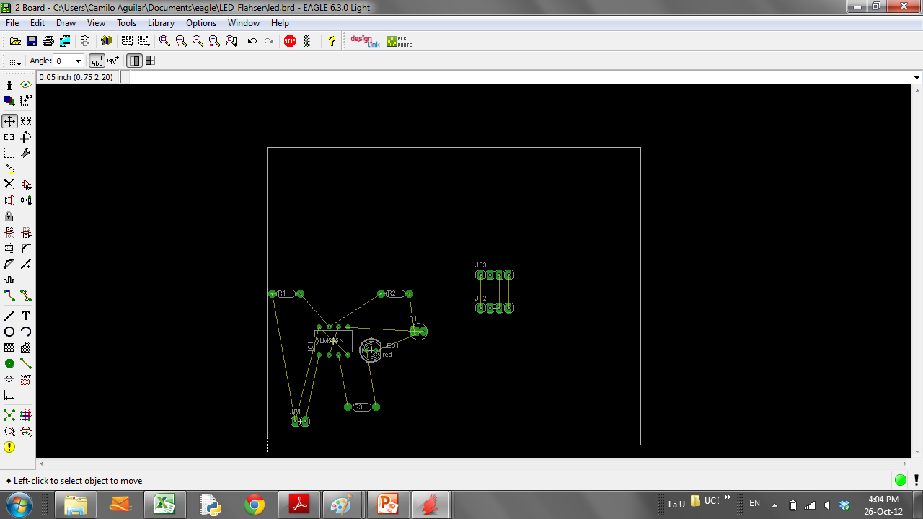
Eagle

Slide 3
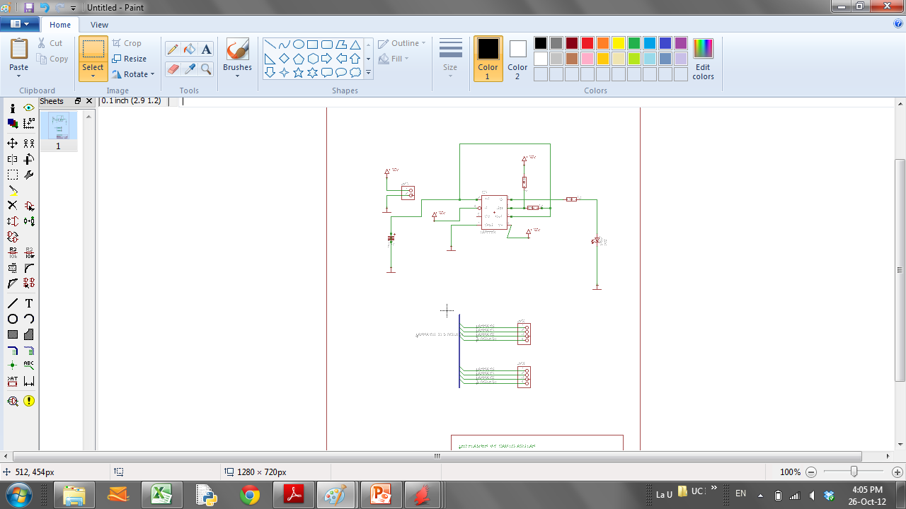

Slide 4
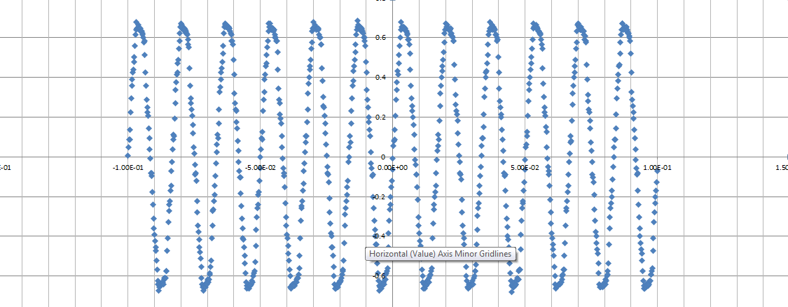
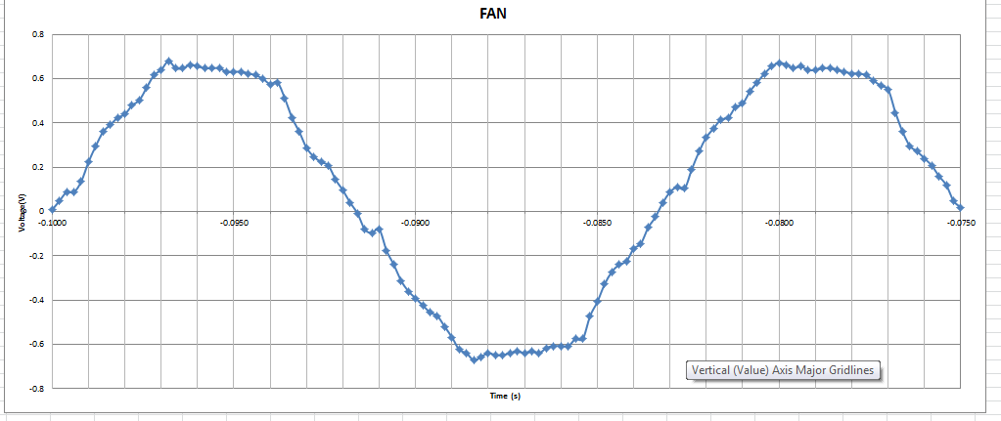

Slide 5
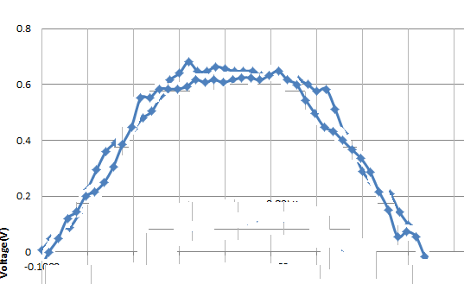

Slide 6
Goals
Better Understanding of Fourier Decomposition
Help developing the code in C
Work and get familiarized with eagle CAD

